Slide 1
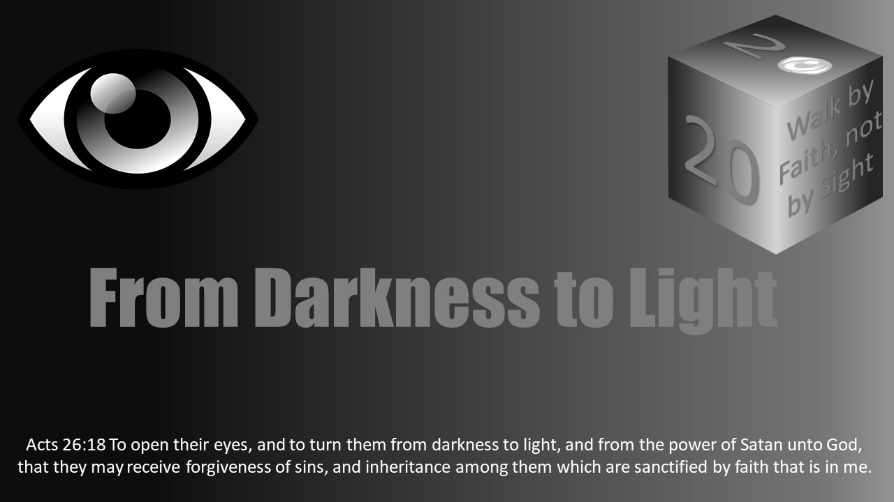

Notes:
The statements of “I” in this lesson as well as a few slides were taken from a lesson I heard preached by Randy Yerby.

Slide 2
Darkness Lesson 15 The Devil's Dark Distortions Too Many Christians Have “I” Problems: PrIde

Slide 3
Introduction
Among the devil’s distortions that darken one’s eternal perspective is the big “I’ problem: “PrIde.”
It encompasses so many areas of sin and is one of Satan’s big three weapons against humanity.
Pride becomes a spiritual blinder to Christians.
It surfaces in various forms: accelerating greed, keeping up with the Jones across the street, holding on to power and position rather than admit their status, failing to be vulnerable enough to confess sin and neglecting to obtain help in following Christ.
Pride is often the etiology of many sins that go by different names like self-righteousness, covetousness, prejudice, and hypocrisy.

Slide 4
What is pride?
Pride means to act arrogantly; a high opinion of ones worth, self conceit.
"Pride, the idolatrous worship of self, is the national religion of hell.”
“Pride is the anti-God state of mind.”
Notes:
Pride simply means to act arrogantly, to have a high opinion of one's worth, or to be self-conceited. Another person defined pride as "over shining, to see one's self as better than you really are. Humility is the lowliness of mind, to see one as they really are in light of God's holiness and our sinfulness." C.S. Lewis is often paraphrased as calling pride as holding the telescope backwards, magnifying self and minimizing the heavens. Someone else defined pride as "the idolatrous worship of self, the national religion of hell." Another person described pride as "the anti-God state of mind." No matter how we define pride, the common denominator is “self,” and pride is not of God. 1 John 2:15-17 mentions three things that are of the world; among them is the pride of life.
Illustration Humor: A young woman went to her pastor and said, "Pastor, I have a besetting sin, and I want your help. I come to church on Sunday and can’t help thinking I’m the prettiest girl in the congregation. I know I ought not think that, but I can’t help it. I want you to help me with it." The pastor replied, "Mary, don’t worry about it. In your case it’s not a sin. It’s just a horrible mistake."
4

Slide 5
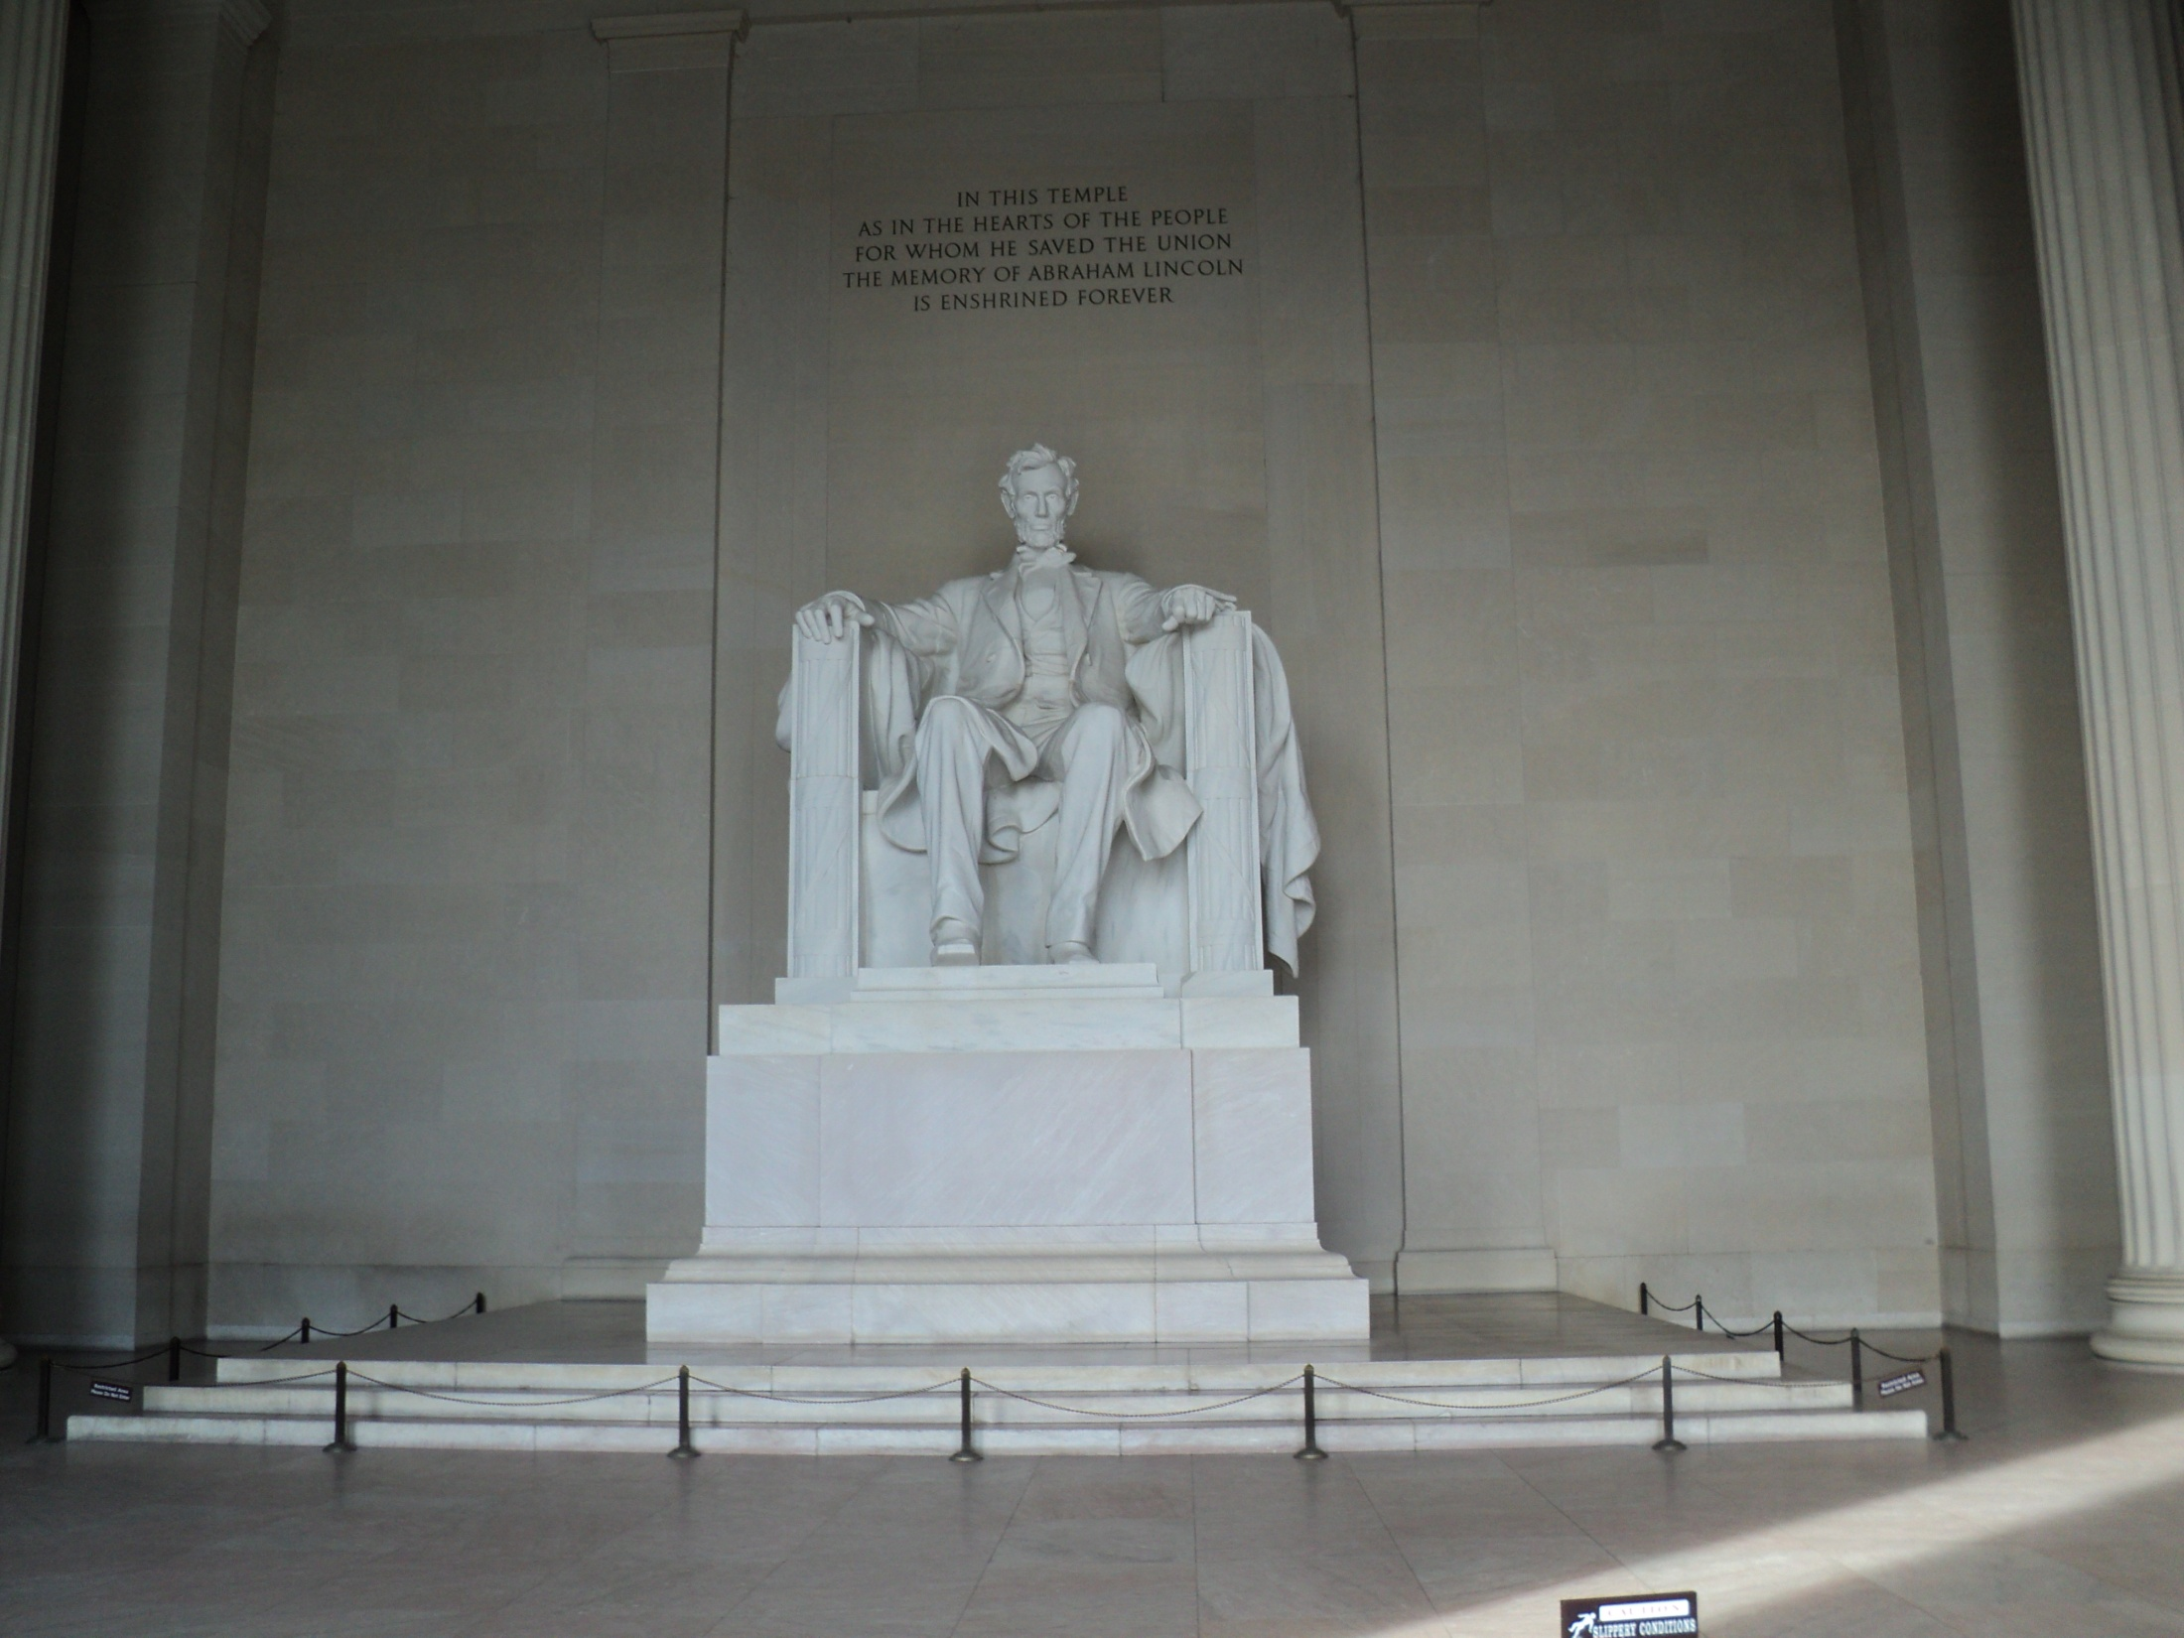
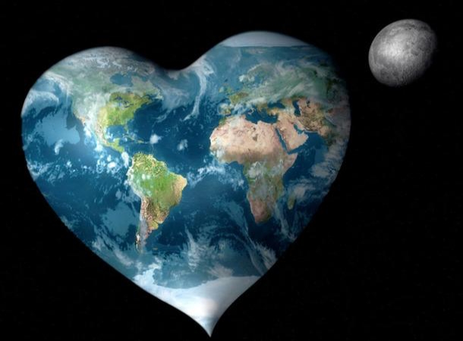
“I have been driven many times to my knees by the overwhelming conviction that I had nowhere to go. My own wisdom, and that of all about me, seemed insufficient for the day.”
1 John 2:15-17; ESV “Do not love the world or the things in the world. If anyone loves the world, the love of the Father is not in him. For all that is in the world—the desires of the flesh and the desires of the eyes and pride of life is not from the Father but is from the world. And the world is passing away along with its desires, but whoever does the will of God abides forever.”
Notes:
5

Slide 6

Big ME Little You Syndrome
Acts 28:25-27 “And when they agreed not among themselves, they departed, after that Paul had spoken one word, Well spake the Holy Ghost by Esaias the prophet unto our fathers, Saying, Go unto this people, and say, Hearing ye shall hear, and shall not understand; and seeing ye shall see, and not perceive: For the heart of this people is waxed gross, and their ears are dull of hearing, and their eyes have they closed; lest they should see with their eyes, and hear with their ears, and understand with their heart, and should be converted, and I should heal them.”
Pride causes spiritual blindness.

Slide 7
Christians are not immune from this "I" problem.
Proverbs 21:2-4 teaches, “Every way of a man is right in his own eyes: but the LORD pondereth the hearts. To do justice and judgment is more acceptable to the LORD than sacrifice. An high look, and a proud heart, and the plowing of the wicked, is sin.”
Proverbs 6:17 summarizes “Haughty eyes are an abomination to the Lord.”
Proverbs 30:11-13 encourages, “There is a generation that is pure in its own eyes, Yet is not washed from its filthiness. There is a generation— oh, how lofty are their eyes! And their eyelids are lifted up.”
Christians can turn their senses from the truth just as easily as non-christians (1 Tim 4:1-3, 2 Tim 4:1-4, Titus 1:13-16).
Too many christians have “I” trouble.

Slide 8
Too Many Christians Are Having “ I ”
Problems
Notes:
Seeing such examples, we should be careful we do turn our eyes away from God’s truth in the Scriptures. We are not immune from this "I" problem. Proverbs 21:2-4 teaches, “Every way of a man is right in his own eyes: but the LORD pondereth the hearts. To do justice and judgment is more acceptable to the LORD than sacrifice. An high look, and a proud heart, and the plowing of the wicked, is sin.” Proverbs 6:17 summarizes “Haughty eyes are an abomination to the Lord.” Proverbs 30:11-13 encourages, “There is a generation that is pure in its own eyes, Yet is not washed from its filthiness. There is a generation— oh, how lofty are their eyes! And their eyelids are lifted up.” Pride blinds humans so easily to even the truths in their own lives. Christians can turn their senses from the truth just as easily as non-Christians (1 Tim 4:1-3; 2 Tim 4:1-4; Titus 1:13-16).
Too many Christians have “I” trouble. This is often apparent in the statements a person makes or thinks such as “I am satisfied with myself” or “I am the perfect example” or “I want things done my way.”

Slide 9
Too Many Christians Are Having Problems

Slide 10
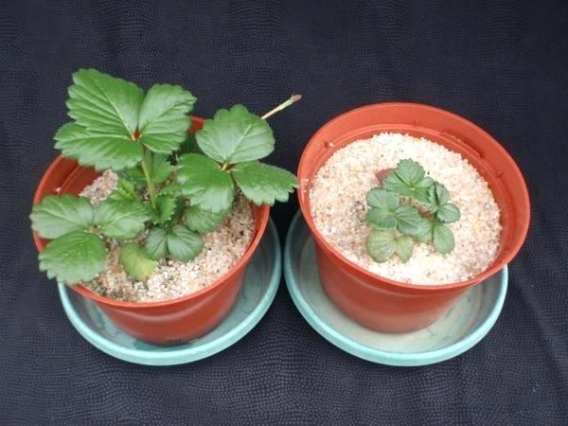
“I Am Satisfied With Myself…”
This statement is made by the Christian who sees no further need in going any farther in their growth as a child of God.
The same attitude that’s described in Revelation 3:1-2; 3:14-17
The attitude of self-contentment. Philippians 2:12; 3:13-14
Notes:
“I am satisfied with myself” is a statement we make when we see no further need to grow as a child of God. Sometimes we are content to remain as a small sprout with self-congratulatory bloom in stunted growth. Pride is often the source of stunted growth patterns in Christians. Such growth often requires chastening so we might become partakers of His holiness (Heb 12:5-11).
The Laodiceans are a good example of being self-satisfied. Revelation 3:14-17 reads, “And unto the angel of the church of the Laodiceans write; These things saith the Amen, the faithful and true witness, the beginning of the creation of God; I know thy works, that thou art neither cold nor hot: I would thou wert cold or hot. So then because thou art lukewarm, and neither cold nor hot, I will spue thee out of my mouth. Because thou sayest, I am rich, and increased with goods, and have need of nothing; and knowest not that thou art wretched, and miserable, and poor, and blind, and naked.” The Laodicean's pride and confidence in their wealth caused them to be lukewarm and blinded when they needed to grow.
Philippians 2:12 and 3:13-14 also encourages those who need to challenge an attitude of self-contentment. Philippians 2:12 reads, “Wherefore, my beloved, as ye have always obeyed, not as in my presence only, but now much more in my absence, work out your own salvation with fear and trembling.” Paul continues in 3:13-14, “Brethren, I count not myself to have apprehended: but this one thing I do, forgetting those things which are behind, and reaching forth unto those things which are before, I press toward the mark for the prize of the high calling of God in Christ Jesus.” Diligence and growth are the challenges for Christians. The New Testament calls Christians to be holy as God is holy, being partakers of the divine nature (Heb 12:10; 2 Pet 1:4). It challenges us to transform (Rom 12:1-2), being image-bearers of God. Pride and self-contentment stop directional growth toward God.

Slide 11

“I Am The Perfect Example…”
This individual definitely thinks more highly of themselves then they should. Romans 12:3
This attitude is centered in pride. Proverbs 6:16-17
The Pharisees were guilty of being self-conceited and self-righteous. Luke 18:9-14
Luke 14:11; “For whoever exalts himself will be humbled, and he who humbles himself will be exalted.”
Notes:
“I am the perfect example.” Sometimes the statement is a little softer but in the same mindset like “I want you to look at me and the good I am doing.” Unfortunately, Romans 12:3 warns us against thinking more highly than we ought to think of ourselves. This is an attitude of pride. Proverbs 6:16-17 teaches, "These six things doth the LORD hate: yea, seven are an abomination unto him: A proud look, a lying tongue, and hands that shed innocent blood....” Likewise, the Pharisees were guilty of being self-conceited and self-righteous in their behavior. Luke 18:9-14 reads: "And he spake this parable unto certain which trusted in themselves that they were righteous, and despised others: Two men went up into the temple to pray; the one a Pharisee, and the other a publican. The Pharisee stood and prayed thus with himself, God, I thank thee, that I am not as other men are, extortioners, unjust, adulterers, or even as this publican. I fast twice in the week, I give tithes of all that I possess. And the publican, standing afar off, would not lift up so much as his eyes unto heaven, but smote upon his breast, saying, God be merciful to me a sinner. I tell you, this man went down to his house justified rather than the other: for everyone that exalteth himself shall be abased; and he that humbleth himself shall be exalted." Humility acts as the guard against pride. We must guard against pride by embracing humility. When we think of ourselves as all that, we fail to see the standard of God's holy, holy, holy nature. In that contrast, the Christian can see their lowly status. The Lord will lift those who humbly serve. In Luke 14:11 Jesus taught, "For whosoever exalteth himself shall be abased; and he that humbleth himself shall be exalted."

Slide 12
“I Will Do Whatever I Want…”
Need
This statement is made by Christians who give in to their own passions, desires, and inclinations.
Demas (Timothy 4:10; “Demas has forsaken me, having loved this present world, and has departed…” )
How can the person who has this attitude pray “Thy will be done”? Matthew 6:10
How can this attitude be dealt with?
Notes:
“I will do whatever I want need to do. is professed by Christians who give in to their own passions, desires, and inclinations. Demas in 2 Timothy 4:10 was such a person. “For Demas hath forsaken me, having loved this present world, and is departed unto Thessalonica....” How can the person who has this attitude ever pray “Thy will be done”? (Matt 6:10).
We sometimes change our wants into needs. By relabeling our wants to needs, we falsely feel we had to act in this way as though there was no other choice. This is a smidge of false humility. Folks always have a choice to obey or not obey God. The Christian’s life and worship are about God not about themselves. If the actions or thought process is not God focused then it is acting out of selfishness and pride. How can we correct this attitude?

Slide 13
“I Want Things Done My Way…”
This statement is made by a Christian who is obstinate, stubborn, and set on having things done his or her own way.
Notice one of the elders qualifications in Titus 1:7.
What happens to people who are self-willed? 2 Peter 2:9-10
The story of the two goats…
Notes:
“I want things done my way.” Or, "I want things done the right way." These statements are often thought but unspoken. Sometimes the latter is heard more like an appeal to being correct while harboring the arrogance of an I-am-right attitude. They reflect a Christian who is obstinate, stubborn, and set on having things done his or her own way. In current vernacular, folks call this being a "control freak." Have you seen this wrong attitude in yourself at some point?
The Bible addresses a self-willed behavior. Notice among the qualifications of elders in Titus 1:7; they are NOT to be "self-willed." This does not mean when in a role of leadership, one should fail to lead. When possible, the leader should not be self-willed in the process. More often, the reverse is true as self-willed individuals speak harshly of those in roles of authority because they did not get their way. What happens to people who are self-willed? 2 Peter 2:9-10 teaches, "The Lord knoweth how to deliver the godly out of temptations, and to reserve the unjust unto the day of judgment to be punished: But chiefly them that walk after the flesh in the lust of uncleanness, and despise government. Presumptuous are they, selfwilled, they are not afraid to speak evil of dignities."
Another illustration is when driving. The father said to his novice driving son to pause for a car even though the son had the right of way. "You do not want to be dead but right because of the aggressive driver." "I want things done my way" can be the curse of “PrIde.”

Slide 14
“I Only Care About What I…”
This statement is made by the Christian who is absorbed in their own self.
“Some Christians are so self absorbed…”
“That they cannot appreciate a funeral sermon because they are not the corpse about whom the nice things are being said.”
Luke 10:30-37 Good Samaritan
Self-centered people are unhappy…
Philippians 2:1-4
Notes:
“I only care about what I want.” This statement is made by the Christian who is self-absorbed. How bad are some about getting only what they want? One preacher remarked, "Some Christians are so self-absorbed they cannot appreciate a funeral sermon because they are not the corpse about who the nice things are being said." Christians are taught the second greatest commandment is to love our neighbors as ourselves. Christianity is about serving others to glorify God in contrast to serving the self.
In Luke 10:30-37, one reads the history of the good Samaritan: "And Jesus answering said, A certain man went down from Jerusalem to Jericho, and fell among thieves, which stripped him of his raiment, and wounded him, and departed, leaving him half dead. And by chance there came down a certain priest that way: and when he saw him, he passed by on the other side. And likewise a Levite, when he was at the place, came and looked on him, and passed by on the other side. But a certain Samaritan, as he journeyed, came where he was: and when he saw him, he had compassion on him, And went to him, and bound up his wounds, pouring in oil and wine, and set him on his own beast, and brought him to an inn, and took care of him. And on the morrow when he departed, he took out two pence, and gave them to the host, and said unto him, Take care of him; and whatsoever thou spendest more, when I come again, I will repay thee. Which now of these three, thinkest thou, was neighbour unto him that fell among the thieves? And he said, He that shewed mercy on him. Then said Jesus unto him, Go, and do thou likewise." What can be learned from these events to help the "I only care about what I want" attitude?
Before going on to the example of Christ, Paul admonished Christians in Phil 2:1-4. "If there be therefore any consolation in Christ, if any comfort of love, if any fellowship of the Spirit, if any bowels and mercies, Fulfil ye my joy, that ye be likeminded, having the same love, being of one accord, of one mind. Let nothing be done through strife or vainglory; but in lowliness of mind let each esteem other better than themselves. Look not every man on his own things, but every man also on the things of others." Pride is a big "I" problem. What other "I" problems are associated with sinful pride?

Slide 15
Do I Have "I" Problems?
"I" trouble will keep you
from becoming a Christian
"I" problems will keep a christian
from serving God faithfully.

Slide 16
Why does god feel strongly about pride?
1. Pride promotes self-sufficiency rather than “God-sufficiency”.
2. Most, if not all sin, has its roots in pride.
3. Pride has the capacity to destroy our lives.
2 Corinthians 3:5 Not that we are sufficient of ourselves to think any thing as of ourselves; but our sufficiency is of God;"
Notes:
Why does God feel strongly about pride? First, pride promotes self-sufficiency rather than "God-sufficiency." 2 Corinthians 3:5 encourages, "Not that we are sufficient of ourselves to think any thing as of ourselves; but our sufficiency is of God". Second, many sins have roots in pride. As one reads in Ezekiel 28:14-15 and Isaiah 14:12-15, Satan's start was his pride before growing further. Another illustration is Israel’s idolatry has origins in pride as one learns in Isaiah 2:6-22. Lastly, pride has the capacity to destroy lives. Proverbs 16:18 teaches, "Pride goeth before destruction, and an haughty spirit before a fall."
If you could avoid a disease that would blind you, would you not want to avoid a spiritually blinding condition like pride? The Christian’s battle is a warfare to bring into obedience anything that exalts itself against God. 2 Corinthians 10:3-5 instructs: " For though we walk in the flesh, we do not war after the flesh: (For the weapons of our warfare are not carnal, but mighty through God to the pulling down of strong holds;) Casting down imaginations, and every high thing that exalteth itself against the knowledge of God, and bringing into captivity every thought to the obedience of Christ."
God points the children of Light to humility. Christians are taught to not think of themselves too highly (Rom 12:3). Jesus demonstrated humility when as master of the Universe, he washed dirty feet in John 13. In Luke 7:36-50, the woman came and washed Jesus’ feet in the presence of Simon a Pharisee and his other dinner guests. Because of Simon’s negative reaction to her sordid reputation, Jesus taught the parable of the creditor. Jesus asks Simon which of the two forgiven of debt will love the creditor more—the one who owed much or the one who owed little? The response was the one who was forgiven more. Perhaps this should cause Christians to do inventory when they feel puffed up. Christians must see the value in others as souls to be brought to God not in terms of the flesh but in recognition that all humans are created in the image of God. All people are the same footing at the cross of Christ.
16

Slide 17
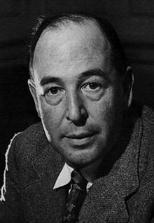
Why does god feel strongly about pride?
C.S. Lewis helped many understand humility when he wrote, “Humility is not thinking less of yourself, it's thinking of yourself less...Pride is a spiritual cancer: it eats up the very possibility of love, or contentment or even common sense."
Pride is humility’s antithesis.
Pride prohibits us from accomplishing what God wants the children of Light to do.

Slide 18
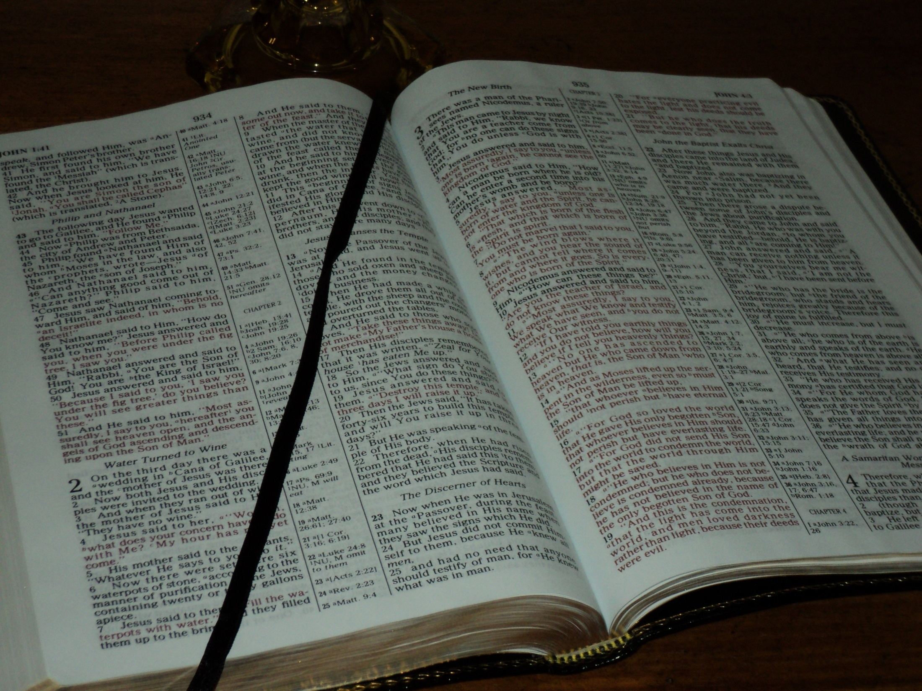
Proverbs 16:18; Pride goes before destruction, and a haughty spirit before a fall.
Notes:
Proverbs 16:18 says, “Pride goes before destruction, and a haughty spirit before a fall.”
I like what a slightly different translation of this verse says: “First pride—then the crash—the bigger the ego, the harder the fall.” I think about sports stars who seem to have it all: fame, money, a great career, relationships. Time after time we see one celebrity or sports star after the next who come out and after living the high life and destroying everything they held dear because they thought they were invincible. Chipper Jones, Deion Sanders, Magic Johnson—all these men let their pride take them over the edge and they suffered deeply for it. But some people don’t get the chance to live to tell about it. God is serious about pride’s destructiveness. But, it’s not just in the sports arena. It’s in the business world. How many times have we been reminded in the last couple of years what happens when greed and pride take over. Very powerful men and women who think nothing of themselves can end up losing it all. It’s not just in the business world either.
Pride is destructive. I want to share with you a form of pride that all of us struggle with in our lives and that is spiritual pride.
18

Slide 19
2 Corinthians 10:3-5
For though we walk in the flesh, we do not war after the flesh: (For the weapons of our warfare are not carnal, but mighty through God to the pulling down of strong holds;) Casting down imaginations, and every high thing that exalteth itself against the knowledge of God, and bringing into captivity every thought to the obedience of Christ.

Slide 20
How do I recognize pride in my life?
Spotty prayer life…
Weariness…
Anger…
A critical spirit..
A defensive reaction to criticism…
Taking responsibility for success, accomplishment,or financial prosperity…
Impatience about having to listen, wait, serve, be anonymous, or be led by someone else…
Copied from Discipleship Journal
A Lack of Thanksgiving
“Pride kills thanksgiving, but a humble mind is the soil out of which thanks naturally grows. A proud man is seldom a grateful man, for he never thinks he gets as much as he deserves.” Henry Ward Beecher
Notes:
So, how do I recognize pride in me? Here are some indications when pride might be creeping into your life:
Spotty prayer life--suggests I am not actively relying on God, nor aware of my need for Him.
Weariness-- is often the result of trying to do more than God intends, which means I am not letting Him order my day.
Anger--can mean I am not trusting God’s sovereign plan and timing, and am trying to take control from Him.
A critical spirit-- the sorry act of bringing others down in order to lift up myself, often points to an inflated sense of self.
A defensive reaction to criticism, despondency after failure, and the inability to laugh at my mistakes all suggest that I am taking myself too seriously and thinking of myself too highly.
Taking responsibility for success, accomplishment, or financial prosperity may mean I have lost sight of God’s gracious and undeserved provision.
Impatience about having to listen, wait, serve, be anonymous, or be led by someone else all hint at an overdeveloped sense of importance.
Unwillingness to associate or get to know a certain person or people who do not live up to your standards. Romans 12:16 says, “Be of the same mind toward one another. Do not set your mind on high things, but associate with the humble. Do not be wise in your own opinion.”
Lastly, a lack of thanksgiving indicates pride.
Henry Ward Beecher wrote, “Pride kills thanksgiving, but a humble mind is the soil out of which thanks naturally grows. A proud man is seldom a grateful man, for he never thinks he gets as much as he deserves.” After recognizing pride, then we must repent of it. We should want to act against our own pride before God does. We must be ready to fight against pride every day.
20

Slide 21
What impact does pride have on confession?
Pride often stops the confession of sin to God. (1 John 1:8-9; James 5:16),
As His child, one must stand in opposition to sin, purposing to purify their life and live holy in imitation of Christ (1 John 3:3; Eph 4:23-24).
1 John 1:8-10 teaches, "If we say that we have no sin, we deceive ourselves, and the truth is not in us. If we confess our sins, he is faithful and just to forgive us our sins, and to cleanse us from all unrighteousness. If we say that we have not sinned, we make him a liar, and his word is not in us."
Those seeking to serve God do not make a habit of sinning.

Slide 22
Pride and Confession
Confession is when one says what God says about their sin (Greek word “Like – Say”). One cannot spin sin with God. “If you mess up, you must fess up.”
Too often, there are those who wish to escape the Lake of Fire who have no desire to put off their carnality and worldliness but instead, cling to it in pride.
Proverbs 28:13 (NAS) “He who conceals his transgressions, will not prosper, But he who confesses and forsakes them will find compassion.”
Christians must put away pride and resolve to practice confession as taught in God's word

Slide 23

Pride and Confession
The church is made up of folks who have had messy lives.
Christians are not exempt from trouble, trials, and even worry.
Temptations and trials are not removed by baptism.
God provides His children with peace, comfort, joy, and hope.
Much of the New Testament was written to Christians who, in some form another, were struggling and needed encouragement and edification.
Trials and hardship are part of the Christian’s transformation or growth.
Just as diamonds and gems are polished with friction, humans are no different.

Slide 24

Pride and Confession
Too often, we can find ourselves playing with sin and pride. We might say we are “struggling” with sin, but often we are comfortable and “snuggling” with sin.
Unfortunately, we often see how close we can get without being burned. When we say we struggle with sin, there is a smidge of confession and humility, but it is not enough to actually put away sin.
We must recognize the pride which enslaves us. When we do not address sin, we are whitewashing the outside but internally are captive to pride.
God knows His children's struggle. Confession allows us to own our pain, being confident God will use that part of our history to draw us closer to Him.
God will also comfort His children with mercy and affection through afflictions. He will not forsake us but will transform us if we let him.
(I am not certain, but I think the first time I read this "snuggle" and "struggle" word illustration was from Dene Ward.)

Slide 25
Pride and Confession
Christians, who often struggle to confess, must have the courage to be vulnerable to be genuinely connected as a member of God’s people.
Everyone connects to others regardless of who they are.
Shame is a form of fear of disconnection. To genuinely connect with others, one must have been seen and been vulnerable.
Those who can, despite confessed failings, have a sense of love and belonging and a sense of worthiness. They understand they were formerly without hope and God but now are citizens of the kingdom and members of the household of God as Ephesians 2:12-19 teaches.
If a person does not feel worthy of love and belonging, then they are not connected, and they fear disconnection or unworthiness – shame as the psychologist might describe it.
Those folks who have a sense of worthiness know they are God’s children, and because of Jesus’ sacrifice are wholehearted. They have made mistakes but corrected course and grown because of it. They are courageous in that they share their story with their whole heart. Courage requires Christians to recognize their imperfections, weakness, and flaws.

Slide 26
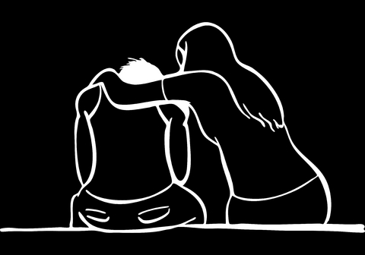
Pride and Confession
The confessing Christian is wholehearted without a façade of pride but instead trusts in God. Wholehearted folks are compassionate toward themselves and others with kindness and care.
Everyone has or will have moments that knock their feet out from under them. Such a moment often leaves one bruised, battered, and bewildered. It is then children of God must lean on God's word and fellow Christians, and in their emptiness and contrite heart turn to God to find comfort (Ps 34:18, 51:17).
The wholehearted let go of what they or others think they should be for who they are. It is not always neat and orderly, but God can make the crooked straight.
Their concern is what does God think about their service -- what God thinks of a person is more important than what others think about the person.
They embrace the vulnerability of confession knowing that which makes them vulnerable makes them beautiful.

Slide 27
Pride and Confession
In contrast, by living humbly, God will give us grace, and exalt us at the proper time (1 Peter 5:5-7).
In fact, although God see everything, He takes special attention to the humble in heart (Isa. 66:1-2). The promises of humility is God's care.
Spiritually beautiful people have been transformed by the renewing of their mind – often through troubles, trials, and temptations. They become image bearers of Christ in holiness and righteousness having remade their heart, mind, and lifestyle.
Those who do not let pride hinder their confession, trust that God is in control, and that He is the justifier. Christians are transformed as they experience personal defeat and still obeyed. Pride is swept away as we trust in God and Christ.

Slide 28
Conclusion
Robert Gordis wrote, “Pride is a deeply rooted ailment of the soul. The penalty is misery; the remedy lies in the sincere, lifelong cultivation of humility, which means true self-evaluation and a proper perspective toward past, present, and future.”
Ultimately, much of Christianity is about being selfless in service to glorifying God instead of being fleshly for the self.

Slide 29
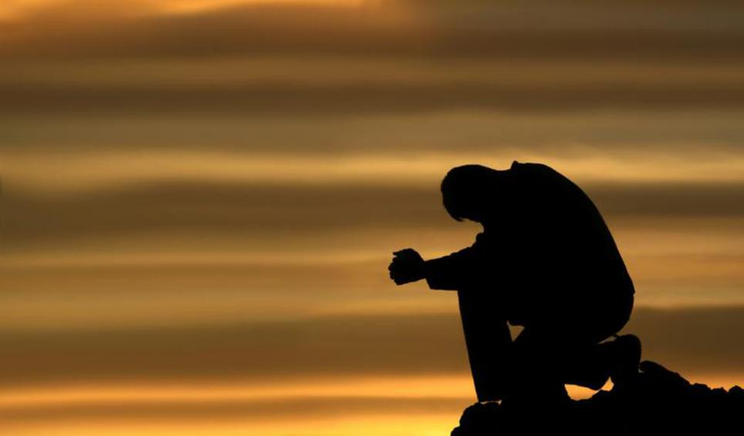
Conclusion
Pride is the core problem; it distorts one's view of eternity.
In 2020, do you have an “I” problem because of pride?
If you do, this kind of “I” problem can keep you from becoming a Christian. It will also deter you from serving God faithfully.
The right attitude for the Christian is to prove and hold fast to that which is good through regular study of the scriptures. (1 Thes 5:21; 2 Tim 2:15; Acts 17:11).

Slide 30
Conclusion
Christians need to keep their hands from covering their eyes and ears and instead keep those hands turning the pages of their Bibles and humbly serving others to glorify God.
Pride causes you to miss so much because your perception of reality is so skewed. You are often blind to reality, not only in this life but especially from an eternal perspective.
The wisdom of God on prIde for those that are spiritually blind may seem like foolishness.
In the end, God will demonstrate His wisdom (1 Corinthians 1:18-21).

Slide 31

Underview: Some Thoughts On Practicing Humility
Notes:
The danger of pride is that God resists and opposes it. Haughty eyes are an abomination to God (Proverbs 6:16ff). Thus, either we will be humble of our own or God will humiliate us. King Nebuchadnezzer had to learn this as he spent time eating grass instead of boasting of his kingdom. Ultimately, one must see themselves as having sinned in contrast to God's holy, holy, holy nature. (See Isaiah's example in chapter 6).
Pride seeks to steal glory from God and exalt itself against God (Isaiah 42:8). Thus, the key to humility is to see God as He is. Even when leading, one must serve and not lord it over others. Jesus demonstrated this in John 13 when he washed dirty feet.
Christians should cast their anxieties on God (1Peter 5:7). Children of light need to stop stressing by trying to fix everything and cast their trust, dependence, care, and reliance on God. God is not limited by power nor wisdom. Thus, God is not anxious about helping His children with a problem.
God's children should also practice adoration and thanksgiving (1 Peter 1:3-5, 4:11, and 5:11). Pride does not grow well in the soil of thanksgiving. By practicing confession of sin (James 5:16), one can see the horror of sin. By being vulnerable in confession, the Christian can be open to receiving healing and help as they confess to God and others.
Further, by inviting and pursuing correction, a Christian will grow by it, even when lots of the invited criticism might not be true. (See Proverbs 12:1). 1 Peter teaches Christians to look to the example of Jesus. Philippians 2:5-8 also teaches to see His example. Thus, Christians should fix their eyes on Christ.
31

